Slide 1
A Psychological Framework for Providing Audiologic Care
Massachusetts Academy of Audiology
9/19/2014
Michael A. Harvey, Ph.D.
508-872-9442
mharvey2000@comcast.net
www.michaelharvey-phd.com

Slide 2
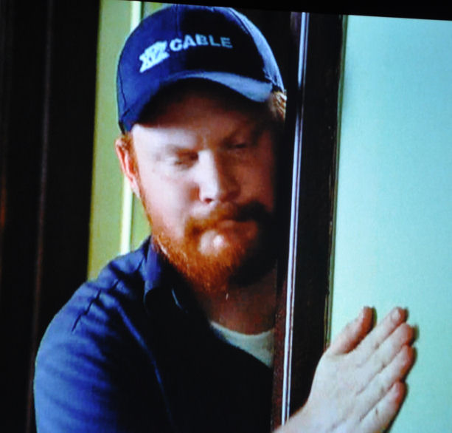
My background

Slide 3

Deborah Dempesy, AuD.

Slide 4
Does this audiologist’s note sound familiar??
“I sometimes feel that much of what my pt talks about is outside of my scope of practice. She often becomes side tracked due to talking about her feelings.
“I hadn’t realized that she was coming to see me for more than her ears.”

Slide 5
Audiologist-Psychologist Dialogue
“If only patients would follow my advice!!!”
Audiology
Dx, Education & Rx HL
Advice
Psychology
Motivation &
Emotional overlay of advice

Slide 6
Audiologist quote:
“Other than informational counseling and listening to the patient, I can't think of any specific psychological strategies that I employ. We’re trained to counsel about causes and effects of HL, treatment options, communication strategies, etc. I'm not convinced we should be significantly involved in the counseling process beyond the informational level.
“You can only wear so many hats and we shouldn't beat ourselves up if we can't solve all of a given pt’s problems.”
And by the way, you don’t have oodles of time for this

Slide 7
Integrating Counseling Skills into Existing Audiology Practices
Kristina English, Ph.D.
53 respondents to questionnaire to Au.D. students with average of 14.6 years of experience
Approximately 50% expressed deep concern about the feasibility of “adding” counseling strategies into already tight schedules.
70% of that group reported that they found ways to “fold” counseling strategies into their practices in ways that did not require additional time.
“I am finding that careful listening/counseling in the beginning is resulting in fewer return visits, so in this way I actually come out ahead, time-wise.”

Slide 8
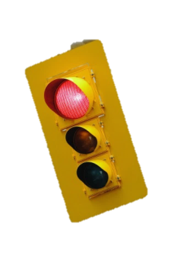
My goal
X
Dx/Rx HL
Psychotherapy

Slide 9
Agenda
Achieving likability,
Mitigating traumatic transference,
Understanding a patient’s psychological construction of HL,
Eliciting and sharing transformative stories,
Motivational Interviewing (summary since Doug did this) & CBT tools
Externalizing the HL,
Facilitating conversational pivotal junctures,
Nuts and bolts of collaboration,
Managing the family and social networks,
Deliberate use of spontaneous humor,
Making effective mental health referrals.

Slide 10
Agenda
Achieving likability,
Mitigating traumatic transference,
Understanding a patient’s psychological construction of HL,
Eliciting and sharing transformative stories
Motivational Interviewing,
Externalizing the HL,
Facilitating conversational pivotal junctures,
Nuts and bolts of collaboration,
Managing the family and social networks,
Deliberate use of spontaneous humor,
Making effective mental health referrals.

Slide 11
What do you notice about the mother’s response??
Question from father: “What did the doctor say about what’s wrong with our son?”
Mother’s response: “He was a very nice man. . . . .”

Slide 12
A 70-year old woman said that she finally got hearing aids after many appointments with many dispensers. I asked her “Why now?”
She replied, “He was the first person to ask me how I’m doing and who wanted to hear my answer.”

Slide 13

“How Doctors Think”
By Jerome Groopman
Question: “On the average a physician will interrupt their patient describing his/her symptoms within ??? period of time?”

Slide 14
According to Jerome Groopman in “How Doctors Think” a doctor interrupts his/her patient after an average of how long?

Slide 15
“What you need in trying to help people are the qualities of a good bartender – sympathy, willingness to listen, and intuition.”
Frank Buchman

Slide 16
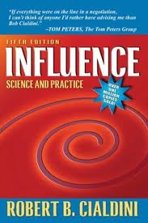
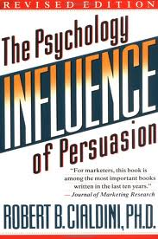
Robert Cialdini
Sold over 1,000,000 copies
Translated into 20 languages
NY Times Best Seller List
Fortune Mag – 75 Smartest Business Books

Slide 17

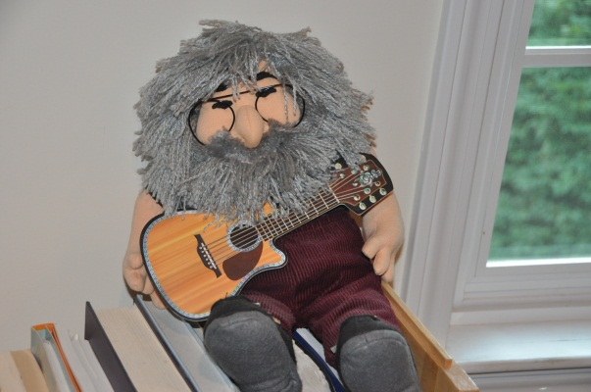

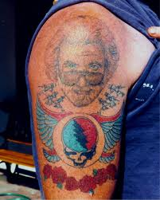
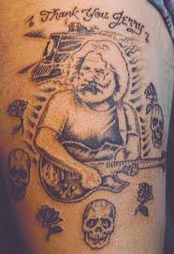
Likability/Connection
e.g., first 5 minutes of job interview
e.g., appt at my office

Slide 18
Agenda
Achieving likability,
Mitigating traumatic transference,
Understanding a patient’s psychological construction of HL,
Eliciting and sharing transformative stories,
Motivational Interviewing,
Externalizing the HL,
Facilitating conversational pivotal junctures,
Nuts and bolts of collaboration,
Managing the family and social networks,
Deliberate use of spontaneous humor,
Making effective mental health referrals.

Slide 19

“White Coat Syndrome”: When patients have a high pulse rate or high blood pressure in the doctor's office but nowhere else.

Slide 20

Amy, 50 y/o hoh woman
“After a brief catch up on events with my audiologist, I’m seated in the dreaded booth, and the door is shut. No matter how many times I have sat in this seat, I’m still uncomfortable. After all it is a test. One for which I hopefully have studied properly.
“My hands feel clammy when I grasp the ‘Push Me’ Button when I hear the tone. For that brief instant before the first ‘note’ I envision a scene from Alice in Wonderland when Alice has fallen down the rabbit hole and faced with a dilemma and a ‘Drink Me’ potion. It’s a scene based on trust before stepping into the unknown.”

Slide 21
Traumatic Transference
I asked Sue whether she thinks her pulse rate changes at her audiologist’s office. Instantly, she nodded her head and I asked why.
“He’s very nice and supportive,” she began. “He tries to make me relaxed and to focus on the positive, but I feel defensive with him, like he’s gonna keep finding things wrong with me.”
“Have you shared your feelings with him?” I asked, already suspecting her answer.
“Of course not!” she immediately responded. “He probably already thinks I’m a basket case.”

Slide 22
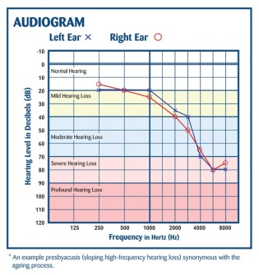
“‘You didn’t hear that?’” the audiologist asked during a hearing exam.
“I’ll never forget when she said that to me, even though it was 25 years ago.”

Slide 23
Traumatic transference:
When someone has been traumatized (e.g., by HL) and is later in a situation that reminds him/her of that trauma (e.g, an audiologic appt).
One transfers the emotions that were associated with an earlier trauma on to a present-day situation that is perceived as similar.

Slide 24
“It’s a hearing test, one for which I hopefully have studied properly.”
“Although he’s supportive, he probably thinks I’m a basket case.”
“I’ll never forget when my audiologist asked me that, even though it was 25 years ago.”
Traumatic transference often
causes shame
(Shame = metastasized guilt)

Slide 25
Lessen your power
Adopt a one down position with respect to learning about how a person experiences HL
“How do you listen when you want to discover another person’s inner world, as opposed to figuring out where someone falls on your map of the world?… I strive to work from a . . position of not knowing…defined as something I’m genuinely curious about, so in that sense it’s a real question, something I don’t know the answer to.”
Carol Gilligan

Slide 26
The following sentences, although perhaps true, are NOT from a one down position
You’re missing appts because you’re angry with me.
You need to use your HA.
You have unresolved feelings about your mother.
Your mother has unresolved feelings about you.
Too much sugar isn’t good for you.
Too little sugar isn’t good for you.
Too little sugar isn’t good for your mother (about whom you have unresolved issues).
Today is Friday, September 19, 2014.

Slide 27
Eg of One down position
Do you think you may be missing appts because you’re angry with me?
What do you think will happen if you don’t use HA?
Do you think you have unresolved feelings about your mother?
Do you think your mother has unresolved feelings about you?
What have you read about the effects of too much sugar?
What do you know about the effects of too little sugar?
Any thoughts about the effects of too little sugar on your mother?
Is today Friday, September 19, 2014?

Slide 28
Relational stance:
The way in which we approach patients, how we position ourselves
Expert/information provider: This is the focus of most medical/allied medical training. “Parent to child”
Appreciative Ally: Respectful curiosity or collaborative inquiry. “Adult to adult.” Provides info and expertise prn, depending on pt’s stage of readiness to change

Slide 29
Appreciative Ally
Would you help me understand how it feels to come to my office for a hearing test?
Please help me understand how you experience your HL.
I’m curious to know what’s most bothersome and least bothersome for you about your hearing.
I know a lot about audiology, but nothing about you. Catch me up!
“expert knowledge”
“local knowledge”

Slide 30
Understanding traumatic transference is relevant to providing effective audiologic care.
A. Only on odd-numbered days
B. Whether or not it is directly verbalized by the patient
C.. Only if it is directly verbalized by the patient

Slide 31
The process of a provider facilitating rapport with a patient should be attended to
A. immediately
B. after the first appointment
C. after a thorough evaluation has been done

Slide 32
Agenda
Achieving likability,
Mitigating traumatic transference,
Understanding a patient’s psychological construction of HL,
Eliciting and sharing transformative stories,
Motivational Interviewing,
Externalizing the HL,
Facilitating conversational pivotal junctures,
Nuts and bolts of collaboration,
Managing the family and social networks,
Deliberate use of spontaneous humor,
Making effective mental health referrals.

Slide 33

Assessing the patient’s construction of HL
1st umpire: “I call them as they are.”
2nd umpire: “I call them as I see them.”
3rd umpire: “They are as I see them.”

Slide 34

What do you see??

Slide 35
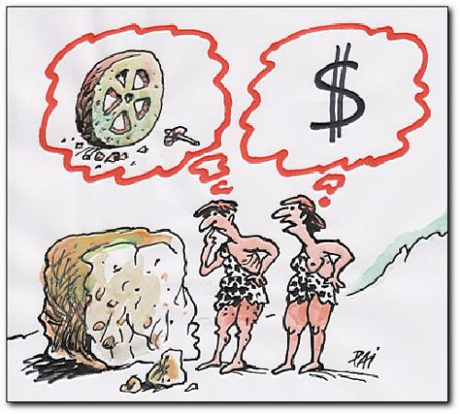

Slide 36
“I hear voices and see energy, but McLean got that wrong: I don’t have schizoaffective disorder. I have expanded spirituality.”

Slide 37

What do you see??
Lost in the Fog

Slide 38
Between two worlds:
Jill’s ambivalence
Deaf world
Hrng world

Slide 39
What is this patient’s “third umpire” construction of HL?
Q: “Why didn’t you get your hearing tested a long time ago?”
A: “I wasn’t ready to get old.”

Slide 40
Empathy =
Understanding one’s third umpire constructions via one-down position
“Would you help me understand . . . ?”
“I can only guess how you feel, as I’m not you.”
“Would you tell me what it’s like to . . . ?”
“You look sad? Are you sad?”
“I understand how you feel.”

Slide 41

“Voiced empathy for my situation/problem” is generally acknowledged as the most important category. We are instructed about the importance of this first word, voiced. It’s not enough for someone to have a sympathetic manner or use a caring tone. The students have to say the right words to get credit for compassion.”
“Empathy isn’t just listening, it’s asking the questions whose answers need to be listened to. Empathy requires inquiry as much as imagination. Empathy requires knowing you know nothing.
Jamison, Leslie (2014). The Empathy Exams: Essays Graywolf Press.

Slide 42

Mike: “You look angry.”
Client: “No, I’m pissed off!!!!”

Slide 43
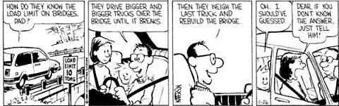
The power of not-knowing

Slide 44
Understanding a patient’s psychological construction of hearing loss
A. Refers to one’s carpentry skills
B Has to do with what sense a patient makes out of his/her hearing loss
C. Isn’t important at all

Slide 45
Agenda
Achieving likability,
Mitigating traumatic transference,
Understanding a patient’s psychological construction of HL,
Eliciting and sharing transformative stories,
Motivational Interviewing,
Externalizing the HL,
Facilitating conversational pivotal junctures,
Nuts and bolts of collaboration,
Managing the family and social networks,
Deliberate use of spontaneous humor,
Making effective mental health referrals.

Slide 46
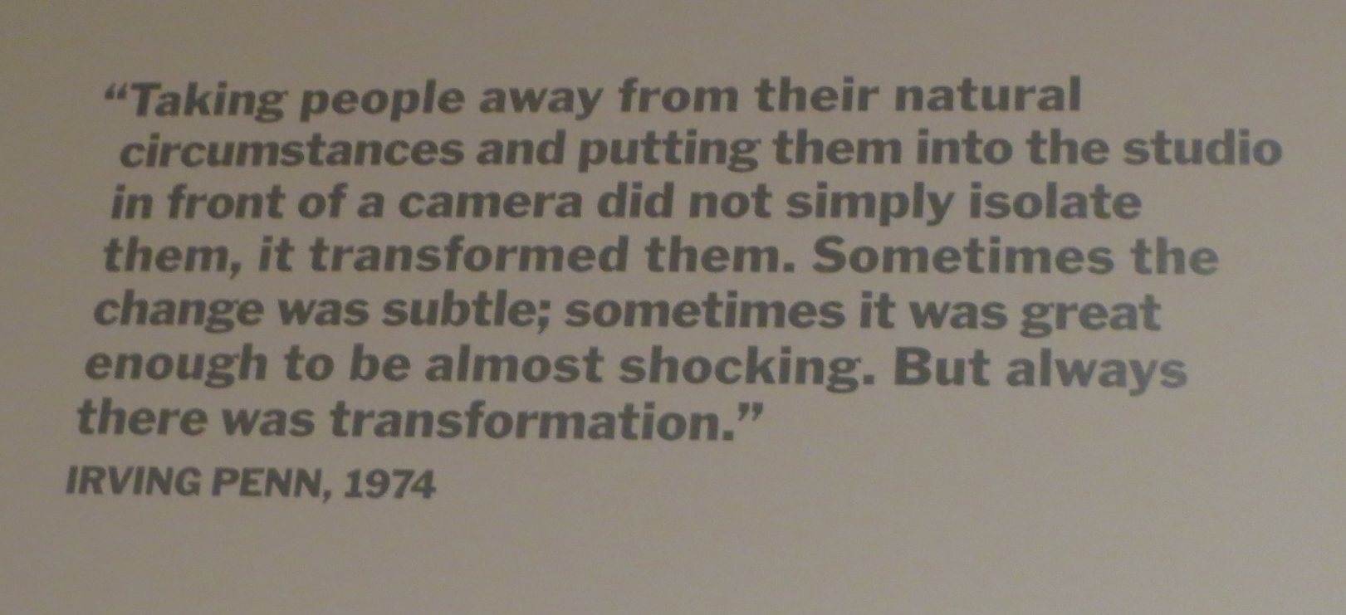
From Museum of Modern Art (MOMA), NYC

Slide 47
The Transformative Power of an audiologist visit
Focus on third point
Sessions bounded by space & time
Imprinting during crisis
Bearing witness to pt’s story

Slide 48
From a mother of a 2 year old daughter with profound HL:
"While Dr. Smith was showing me how the hearing aid worked, I couldn’t help blurting out ‘It’s so unfair for my poor little girl’ and I started to cry. He stopped for a second and said in a very soft, kind voice, ‘You know, everyone has some kind of burden; she’s going to be okay.’
I felt the beginnings of hope. So I asked him more about what the audiogram meant. He explained it again.
Funny thing is that I don’t remember what he said. But I do remember that during that time with him, everything became so simple, so clear! Everything became okay!"

Slide 49
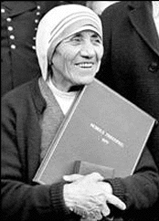
“They may not remember what you said or did, but they’ll remember how you made them feel.”
Mother Theresa

Slide 50


“Even though I’m an audiologist and not a psychotherapist, I’m having a psychological impact. Better that I figure out how to maximize this impact.”
Although audiologists are not psychotherapists, they make psychotherapeutic interventions.

Slide 51
Bermuda, Here I Come!
Letter from a mother for the annual convention of (then called) Assoc Dispensing Audiologists, Oct 27, 1999
"Dear audiologists,
“Thank you for touching peoples’ lives through some very difficult moments. You give me a sacred gift for which I don’t have enough words to properly say thank you.
“Let me try anyway... Thank you for your technical expertise: your ability to explain what all those knobs do and what they mean. But most of all, thank you for being there, for listening, for your comfort and for your patience - for making it possible for me to leave your office with confidence and hope.
“Tommy is now 15 years old and he’s a happy kid and doing well in school. His hearing loss has become a normal part of our lives largely because of you. I bet your clients ‘double click’ you to meetings in their heads like I still do without you even knowing it; and that your spiritual presence in their lives helps make everything okay.
“With much gratitude and love, Joan.”

Slide 52
The magic of sharing instructive stories
with pts
T: “How do you feel about . . . ?”
Pt: “Ok.”
T: “What do you think about . . . ?”
Pt: “Dunno
T: “Hey, do you wanna hear a story?”
Pt: “SURE!!”

Slide 53
“Instead of asking pts “How do you feel....?" it often works for me to say "I find that many people with your kind of HL can have problems with ...e.g. social groups, feeling bad about not hearing in meetings, having their HA whistle in public, etc. Do you think that this could be a something that might happen to you?"
“This approach usually leads into all sorts of things in less direct way.”
Audiologist

Slide 54


Slide 55
“When I grieved that I’ll never be as good a golfer as I wanna, I realize I’m enjoying it more!”
hear as much

Slide 56
Dear Mom and Dad,
If you only had known.
Love, Sue

Slide 57
Sudden profound hearing loss
The story of Carol

Slide 58

The power of advising other people via their stories
“I know another person with HL who . . . If you were his best friend, what would your advice be to him?”
“We need to nurture ourselves the way we might nurture our best friend.”
Oprah

Slide 59
An audiologic visit can be transformative because
A. It is in an office
B. In part, because it is bounded by space and time, it sets the stage for patients to share emotional issues
C. Of the shortage of mental health professionals

Slide 60
Agenda
Achieving likability,
Mitigating traumatic transference,
Understanding a patient’s psychological construction of HL,
Eliciting and sharing transformative stories,
Motivational Interviewing & CTB tools,
Externalizing the HL,
Facilitating conversational pivotal junctures,
Nuts and bolts of collaboration,
Managing the family and social networks,
Deliberate use of spontaneous humor,
Making effective mental health referrals.

Slide 61
Q: How many psychologists does it take to change a light bulb?
A: It doesn’t matter, it has to be motivated to change.

Slide 62
A common patient psychological dynamic:
People tell me I need help,
but I disagree.
Therefore, I will ask for help, but not accept it.
The doctor explains how treatment will help.
This makes me angry, but I cannot show it
because that will make the doctor talk more.
So I’ll nod my head and plan my escape.
A common health-care provider dynamic:
It’s clear that the patient needs help.
If I explain this thoroughly enough and convey my expertise,
then the patient will trust me and accept my help.
I know I’m succeeding at this
because the patient is nodding in agreement.

Slide 63

Motivational Interviewing
A directive, patient-centered counseling style for increasing intrinsic motivation by helping patients explore and resolve ambivalence.
(Miller & Rollnick, 2002)

Slide 64
What motivational interview is NOT
Listening and keeping quiet
Ordering, directing, commanding
Warning or threatening
Giving advice, making suggestions, providing solutions
Persuading with logic, arguing or lecturing
Moralizing, preaching or telling pts what they should do
Disagreeing, judging, criticizing or blaming
Agreeing, approving or praising
Shaming, ridiculing or labeling
Interpreting or analyzing
Reassuring, sympathizing or consoling

Slide 65
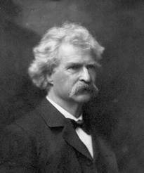
"Denial ain't just a river in Egypt."
Mark Twain
It is vital for providers to determine a pt’s readiness and ability to change:
to determine a pt’s Stage of Change.

Slide 66
Stages of Change
Prochaska, Norcross & Diclemente
Pre-contemplation: Pt denies problem
Contemplation: Pt is ambivalent about change
Determination: Pt requests change.
Action: Pt accepts solution to problem.
Maintenance: Pt practices strategies to maintain change.
Relapse: Pt practices strategies to prevent relapse
“Pretreatment”

Slide 67
Pre-contemplation: Pt denies problem
Contemplation: Pt is ambivalent about change
Determination: Pt requests change.
Action: Pt accepts solution to problem.
Maintenance: Pt practices strategies to maintain change.
Relapse: Pt practices strategies to prevent relapse
“My wife thinks I need hearing aids. I love her to death, but she doesn’t know what she’s talking about. She needs to learn to enunciate her words better, to speak more clearly. She’s blaming my ears for her own shortcomings. Just like her mother who always blamed her father for everything. My hearing is just fine, thank you!”
What is the stage of change with this person re her use of hearing aids?

Slide 68
Pre-contemplation: Pt denies problem
Contemplation: Pt is ambivalent about change
Determination: Pt requests change.
Action: Pt accepts solution to problem.
Maintenance: Pt practices strategies to maintain change.
Relapse: Pt practices strategies to prevent relapse
“I know that it’s not good to keep losing my hearing aids cuz I want to hear my teacher, but I don’t like the way other kids look at me. And when I don’t wear them, they stop making fun of me but then I get behind in class and my parents yell at me. Ugh. What do you think I should do?”
What is the stage of change with this person re her use of hearing aids?

Slide 69
Pre-contemplation: Pt denies problem
Contemplation: Pt is ambivalent about change
Determination: Pt requests change.
Action: Pt accepts solution to problem.
Maintenance: Pt practices strategies to maintain change.
Relapse: Pt practices strategies to prevent relapse
“Please Dr. Audiologist. Help me!! I want the best hearing aids on the market. I’ll do anything!!!
What is the stage of change with this person re his purchase?

Slide 70
Pre-contemplation: Pt denies problem
Contemplation: Pt is ambivalent about change
Determination: Pt requests change.
Action: Pt accepts solution to problem.
Maintenance: Pt practices strategies to maintain change.
Relapse: Pt practices strategies to prevent relapse
“I kinda want a cochlear implant. It’ll make my parents happy because maybe I’d be able to talk better and to hear them calling me. But yech! Drilling a hole in my brain! I shouldn’t have to change to please them. They should learn sign language to please me! But am I being selfish?”
What is the stage of change with this person re his CI?

Slide 71
Pre-contemplation: Pt denies problem
Contemplation: Pt is ambivalent about change
Determination: Pt requests change.
Action: Pt accepts solution to problem.
Maintenance: Pt practices strategies to maintain change.
Relapse: Pt practices strategies to prevent relapse
“Suddenly everything is clear. I don’t know why or how this happened, but it doesn’t matter because, as I said, it’s now so so so very clear. Why didn’t I realize this truth 30 years ago??!! I know what I need to do in order to feel happy, fulfilled, physically fit and spiritually enlightened. Without question or any hesitation whatsoever, I need to go to MANY more Mass AAA workshops like this one.”
What is the stage of change with this person re his going to more Mass AAA workshops?

Slide 72
Use different approaches depending on a pt’s readiness for change.

Slide 73

“I know that it’s not good to keep losing my hearing aids cuz I want to hear my teacher, but I don’t like the way other kids look at me. And when I don’t wear them, they stop making fun of me but then I get behind in class and my parents yell at me. Ugh. What do you think I should do?”
What do you think would happen if you answer her question with “Never mind those kids. You should wear your HA at school.”

Slide 74
“To tell you the truth, my wife won’t get off my back until I come here and get my hearing tested. She thinks I need hearing aids, but she overreacts and again, to be frank, she’s really beginning to piss me off! Ugh. What do you think I should do?”
What do you think would happen if you answer his question with “Your hearing test indicates you would benefit by hearing aids.”

Slide 75
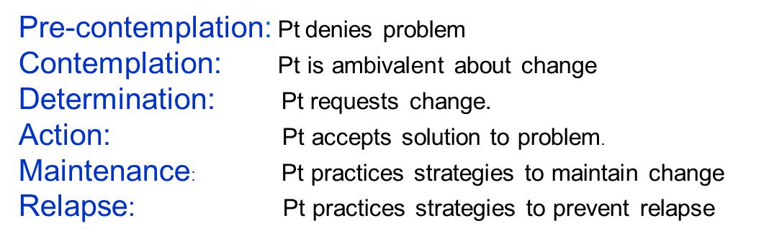

Advice doesn’t work here and typically has the opposite effect!!!

Slide 76

Practitioner advocates for change
Patient advocates for staying the same
“You should change” “I don’t wanna change.”
“You’re be better off with HA” “Things aren’t half-bad.”
“You’re ready to… “No, I’m not ready to.”
“You’ll have poorer quality of life” “Uncle Fred is 89 and he’s doing fine”

Slide 77

Don’t touch that fruit!!!!
If only God had used Motivational Interviewing techniques with Adam and Eve!!!!

Slide 78
Goal: To elicit Self-Motivational Statements (Change talk) from patient
Problem recognition: e.g., “I guess there’s more of a problem than I thought.”
Expression of concern: e.g., “I’m really worried about…”
Intention to change: e.g., “I think it’s time for me to…”
Ability to change: e.g., “I think I can do it.”

Slide 79
Eliciting problem recognition (X)
“Tell me about X.”
“When did you first notice it?”
“Where or in what situations do you notice it the most?”
“In what ways do you think you or other people have been affected by X?”

Slide 80
Eliciting concern
“What worries you about X? What can you imagine happening to you?”
“How do you feel about X?”
“Where are you not comfortable because of X?

Slide 81
Eliciting intention to change
“What wud be most impt benefit of changing X?”
“If you were 100% successful and changing X worked out exactly as you would like, what would be different?”
“Given that you change X, how would your life improve?”
“How has X stopped you from moving forward, from doing what’s most important in your life?”

Slide 82
Eliciting ability to change
“Do you think you can you change X?”
“What might stand in your way of changing X?”
“How would you like to proceed from here. Now what?

Slide 83
Eliciting importance/concern
How important is it for you to change right now?
0 -------------------------------------------------------------------------10
Not at all Extremely
important important

Slide 84
Eliciting confidence
2. If you did decide to change, how confident are you that you could do it?
0 -----------------------------------------------------------------------10
not at all extremely
confident confident
Why are you at [x#] and not at 0?
What would need to happen for you to raise your score a couple of points?
How can I help you get there?

Slide 85

Affirmation:
Recognize, Support, & Validate pt’s feelings
“Many people with problem X feel…”
“It’s normal to feel…”
“It sounds like you’re still struggling with making these changes, but you’ve made some changes. It’s not as easy at it looks, huh?
Avoid “I understand how you feel” & “You’re in denial
It doesn’t mean agree with pt’s experience (Martian story)

Slide 86
Q: “Why can’t I save time and administer a questionnaire?”
A: “Cuz it’s important for patient to tell you his/her story.”

Slide 87

“Every decision has some
level of ambivalence”
Sigmund Freud
“I asked for hearing aids,
but didn’t want them!”
To “decide” means to kill an option (to grieve a loss)
“cide”: kill as in homicide
“de”: either/or

Slide 88

Core Concept:
Managing Pt Ambivalence
I wanna
I don’t wanna

Slide 89
Principle of healing:
Pain has a size and shape, a beginning and end. It takes over only when not allowed its voice.

Slide 90
Principle of healing reducing the effects of ambivalence:
Pain Ambivalence has a size and shape, a beginning and end. It takes over only when not allowed its voice.
X
X
X
X
X
What you don’t talk about can hurt you.

Slide 91
A decisional balance sheet:
To come or not to come to this workshop.
Come to workshop Don’t come
Maybe I’ll learn something
A break from paperwork
3 Will see old friends
1. Will catch up on paperwork
2. Can sleep later maybe
3. Don’t have to be polite to people I don’t wanna see.
Benefits
1. Some/all of it may be boring
2. I never liked Mike Harvey much anyway
3. The paperwork only piles up and gets worse
1. Maybe I’ll miss out on ways to work w pts better
2. I won’t see Jack/Jill who I have a crush on
3. I miss a vacation-type day
Costs

Slide 92
Joan’s decisional balance sheet
No hearing aids Hearing aids
Will hopefully die soon and be with deceased husband in heaven
Finally get last word with my son.
3. Avoid stigma of looking old.
1. More involvement with family.
2. More enjoyable listening to music, tele
3. Less fatigue and anxiety hearing.
Benefits
1. Miss out with grandchildren.
2. Not hearing movies.
3. Will miss out with TV & music
1. Son might say “I told you so.”
2. Son and his sister would fight.
3. Abandoning deceased husband.
Costs

Slide 93


The practitioner should get the patient to do most of the talking: to verbalize rationale for change
Self-Perception Theory: What the pt says about change is probably what they’re gonna do…

Slide 94
“When I’m nervous I sometimes talk too much.”

Slide 95
Cognitive Behavior Therapy (CBT)
Thoughts Feelings Behavior
The way we think about things (e.g. HL) affects how we feel emotionally and then how we behave.

Slide 96
Irrational beliefs
(self-talk)

Slide 97
Right product; wrong message
“An underlying social norm which views hearing healthcare (at best) as generally irrelevant and (at worst) as a threat.”
“Traditionally, HHPs (Hearing Health Professionals) have invited people to discover they have a ‘condition’ or a hearing impairment, while detailing how bad their condition is (i.e., how flawed the person is) while pointing out the negatives (i.e., ‘these are the sounds you can’t hear…’). HHPs subsequently offer a solution (hearing aids) that is often unexpectedly expensive and may come loaded with negative associations attached to it.”
Beck, D.L & Alcock, C. J. Right product; wrong message. Hearing Review. 2014: 21(4), 16-20.

Slide 98
Step 1: Begin where the patient is at. At the outset, it is critical to at least briefly elicit from patients what societal negativity about hearing healthcare they may have internalized and then to convey an appreciation and validation for how they feel.
Pt: “It’s not my ears. My wife mumbles.”
Audiologist: “Wow, you’re the up-teenth person who’s told me this. It must be an epidemic!” (smiles)
Pt: (smiles)
Audiologist: “Yeah, many people get the message that having trouble hearing is something to be ashamed of, and they’re afraid of flunking the hearing test, like flunking a final exam. Is that kinda how you feel?”
Pt: “Yeah, that’s me.” (nods his head).

Slide 99
Step 2: Educate patients that they have internal conversations going on in their head that influence their feelings and behavior
Pt: I try not to join conversations because I would only fail. It makes me look stupid.”
Audiologist: “If you continue choosing to think that evidence of hearing loss makes you look stupid, what will you then feel?”
Pt: “Embarrassed, inadequate . . . “
Audiologist: “And then what will you do?”
Pt: “Stay at home and make myself a good stiff drink.”
Audiologist: “Your thoughts wield a lot of power, huh?”
Pt: “Yeah, they sure do.”

Slide 100

Step 3: I think, therefore I am. Emphasize that as human beings, we have the ability to choose what we think.
“You wanna fly, you got to give up the shit that weighs you down.”
Toni Morrison

Slide 101
Audiologist: “Your decision about what to think is the key! Many people with hearing loss discover that they’re thinking tons of thoughts that they’re not even aware of, and that cause them to feel lousy about themselves and hearing aids. Are you curious about this?”
Pt: “I guess.”
Audiologist: “Could I give you some bedtime reading material and maybe get your reactions to it next time we meet?
Pt: “Sure.”

Slide 102
Step 4: Suggest alternative, rational cognitions.
Pt: “Ugh, I can’t hear so many of the tones, so I’m remembering many times that I’m in situations and I get so anxious that people will think less of me because I’m either not answering them or I’m responding inappropriately to what I’m guessing they’re saying. I’m embarrassed because I look stupid.”
Audiologist: “If people think less of you or stupid, you think you’re pitiful and stupid?”
Pt: “Something like that.” (She looks down and shakes her head.).
Audiologist: “Many people with hearing loss tell me that they fall into the trap of thinking like that. It’s not only you. But did the reading I gave you give you any ideas about how you can decide to change your thoughts about this?”

Slide 103
Pt: “Hmmm.” (produces the article). “Yeah, I can choose not to subscribe to ‘emotional reasoning’: the belief that what we feel must be true automatically is true; that if I feel stupid, then I must be stupid, and other people will view me as such.
“I can also stop ‘catastrophizing’ about the possibility that people think I’m stupid. While it would be swell if everybody thought I was real smart, that’s not a necessity for me to remain alive and be happy. I have a core group of family and good friends who are affirming and I do care about what they think.”

Slide 104
“Finally, even if some people really think I’m stupid, their approval isn’t necessary for my survival. I need to stop what has been called ‘MUSTerbating in public’: holding on to the belief that people MUST approve of me, MUST like me; MUST think I’m smart. If some people think I lack intelligence because I can’t hear certain things, it’s because they’re pitiful, not me!”

Slide 105
Step 5: Create an association between hearing healthcare and rational thoughts
It is essential that patients experience heightened self-esteem and pride – the opposite of shame – by embracing hearing healthcare and therefore getting more of what they value.
Story of a man with multiple sclerosis who had great difficulty walking but wouldn’t use a wheelchair because it was intolerable to him that people may pity him, that is, until he wanted to visit a museum exhibit that was surrounded by cobblestones. It was only then that he decided to “connect” his using a wheelchair to rational thinking: “I deserve to honor my wants and needs rather than remain subjugated by my belief that what people may think is so damn important.”

Slide 106
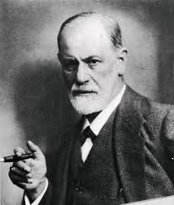

Mike, isn’t this crossing a professional boundary by attempting to practice psychotherapy?
I agree, I didn’t test pts’ hearing and audiologists shouldn’t do psychoanalysis!!!
I can’t speak about your profession, but it seems to me that offering pts rational coping thoughts about HL while using tools from psychology isn’t doing psychotherapy.

Slide 107
An audiologist can elicit emotional reactions of patients within a specific time constraint by
A. talking very fast.
B. lecturing.
C. asking about emotional issues while reminding the patient that there is limited time.

Slide 108
Agenda
Achieving likability,
Mitigating traumatic transference,
Understanding a patient’s psychological construction of HL,
Eliciting and sharing transformative stories,
Motivational Interviewing,
Externalizing the HL,
Facilitating conversational pivotal junctures,
Nuts and bolts of collaboration,
Managing the family and social networks,
Deliberate use of spontaneous humor,
Making effective mental health referrals.

Slide 109
What do you notice about these questions?
“What has the Guilt tried to talk you into about yourself?”
“How has the Fear tried to convince you that it’s unsafe to go out of your house?”
“How long has the Jealousy been trying to get between you and your friends?”
“What does the Blame have you doing with each other?”
“How much does the Bickering get in the way of your conversations?”

Slide 110
We have a relationship with our problems
Not “I am depressed.”
Depression
Rather, “I am affected by the depression.”
Depression

Slide 111
Pts have a relationship with a Hearing Loss
Not “I have a HL.”
Not “I am hearing impaired.”
Hearing Loss
Rather, “I am affected by the hearing loss.”
Hearing loss

Slide 112
The person is not the problem; the problem is the problem.
Patient Therapist
“I am unmotivated” = “The problem has affected your energy level.”
“I am depressed” = “The depression makes it hard for you to go out.”
“I am a worrier” = “The worry tries to stop you for trying new things.”
“I am hearing impaired” = “The HL tries to isolate you from people.”

Slide 113
Example 1: 67 y/o Fred: “I came here to get my wife off my back.”
First minute; first session
“What’s your wife on your back about?” I asked.
“What?” Fred asked.
“What’s your wife on your back about?”
“Oh, she wants me to get hearing aids.”
“It sounds like a battle between you and your wife,” I said.
“What about my wife?” Fred asked.

Slide 114
“Bear with me, would you? Imagine, please, that the hearing loss is sitting in the empty seat in front of you. It’s so smart that it can even sit! What does it look like? How big is it? What color? What’s it wearing? Is it friendly or mean? What’s its name?”
“It’s dark and heavy, real strong, over 6 feet tall, has bulging muscles and is wearing an Army uniform. And it’s mean, real mean. His name is Joker [Batman’s nemesis].”

Slide 115

We Externalized the Hearing Loss
Therapist
The HL aka Joker
Fred
The person is not the problem; the HL/Joker is the problem.

Slide 116
The helper becomes an
investigative reporter
It is important to stay on track with the task of understanding how the HL operates. Do NOT try to treat the HL (Do not try to help)
Instead try to develop an expose on the life and the identity of the HL and its relationship to the pt.

Slide 117
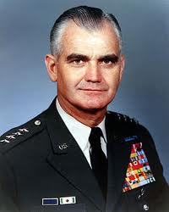
“The inability to understand the enemy was ‘the basic error’ in the conduct of the war in Vietnam.”
General William Westmoreland

Slide 118
Exploring the history and current effects of the problem (e.g., HL)
Eliciting a personal description of problem [eg., the Joker]
Mapping the effect of the problem [conflicts w spouse]
Eliciting the pt’s position or sentiments re the effects of problem’s activities [don’t like it]
Eliciting the why??? The pt’s personal explanation or justification for that position/sentiments [I value my marriage]

Slide 119



Audiologist
1. Eliciting a “third umpire” description of the HL
The HL
Pt
What form(s) does the it take?
What do you call it? What is its name?
What do you imagine it looks like? Big, small, heavy, light?
What is its personality? Mean, friendly?
What is its strength, weakness?
If it had a voice, what would it say?

Slide 120
Example 2: Sue
Audiologist
The Eternal Eclipse
Pt
“My HL is like a shadow, like when the moon eclipses the sun. It’s an eclipse that leaves me in the dark and cold. It’s an eternal eclipse because it’s not temporary like others. It’s huge, very heavy and very dark. An eternal eclipse.”

Slide 121
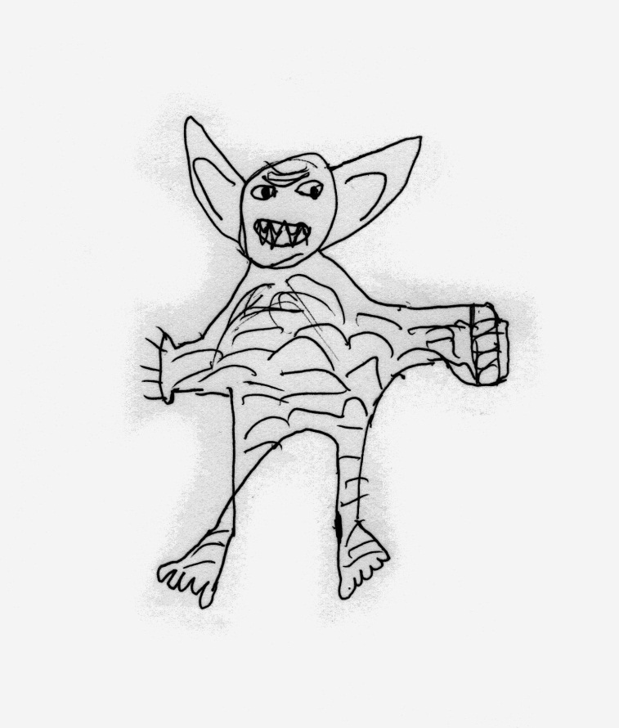
Example 3: Jason
9 y/o Jason’s drawing of “The Hearing Loss”
“The HL is a mean, green, strong, pointy-eared monster. . . I’m not sure what he wants. . . He wants me to hear worse.”

Slide 122
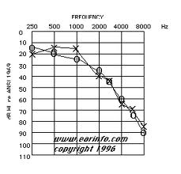


New Names for Hearing Loss
By Fred By Sue By Jason

Slide 123
2) Mapping the effect of the problem
The investigative reporter (formerly the audiologist) can investigate how the HL has succeeded in disrupting and has failed to disrupt the pt’s life.
Audiologist
The Joker
The Eternal Eclipse
Pt
pointy-eared monster

Slide 124
An inquiry into the HL’s successes:
The HL’s influence in the different areas of one’s life (e.g., its effects on the one’s relationships with others, on one’s feelings, on one’s thoughts, on one’s story about who s/he is a person)
The strategies, the techniques, deceits, and tricks that the HL has resorted to in its efforts to get the upper-hand in one’s life.
The special qualities possessed by the HL that it depends upon to undermine the one’s knowledge and skills and to impose its authority on the one’s life.

Slide 125
Investigative reporter questions re HL’s successes, continued:
The purposes that guide the HL’s attempts to dominate one’s life, and the dreams and hopes that the HL has for one’s life.
Who helps with the HL achieve its goals?
The plans that the HL has ready to put into action should its dominance be threatened.

Slide 126
An inquiry into the HL’s failures:
What aspects of one’s life that s/he still has some influence despite the HL’s influences.
The counter-techniques, counter-strategies, and the tricks that have been developed by the person that have at times been effective in preventing the HL to get the upper hand and impose its authority on one’s life.
The special qualities, knowledge, and skills possessed by the person that have proven difficult for the HL to undermine and to disqualify – including the "self-talk" that one has developed .

Slide 127
Investigative reporter questions re HL’s failures, continued:
The purposes and commitments that have frustrated the dreams and the hopes of the HL.
Who stands with the person (relatives, friends, acquaintances, teachers, therapists, and so on), and the part they have played in denying the HL’s desires and wishes.
The options that are available to a person for taking advantage of the HL’s vulnerabilities and for reclaiming his/her own life.

Slide 128
Fred’s summary of the effects of the HL
“It [HL] turns my wife into a nag, shuts me out from family gatherings, makes me feel lousy and depressed and angry . . . Maybe one of the hearing loss’s tricks is that it makes me think that other people are mumbling.
The hearing loss is very smart and real tricky. The hearing loss wants control of me, probably because it has nothing better to do. He screws up my relationships so even my wife makes me come here to play this stupid game – no offense, doc.”
“No offense taken,” I smiled.

Slide 129
3. Eliciting the pt’s position or sentiments re the effects of the problem
“Why do you think the problem is a problem?”
“Are these (the problem’s) activities okay with you?”
“Where do you stand on these outcomes?”
“What’s it like for you?”
Should elicit helpful and non-helpful effects of problem – pros and cons.

Slide 130
4. Explaining one’s justification for his/her position/sentiment
e.g., “Why do you think you’re taking this stand/position re the problems?”; “Why is this not okay (or okay)?”
e.g., “Would you tell me a story about your life that would help me to understand why you would take this position re your problems?”
Persons articulate what they value about their lives and identities; their longings, values, hopes, dreams, commitments; what is precious to them

Slide 131
Eliciting Fred’s position re the effects of the problem and his justification for his position:
T: “Do you like the fact that the Joker is beating your ass?”
C: “Of course not. That’s a stupid question!”
T: “It may seem obvious to you, but some people are more resigned and aren’t up for a fight.”
C: “Well, I’m a fighter. I’m a fighter from way back!”
T: “Who taught you to fight?”
Fred said his grandfather was a Second Lieutenant in World War II. I asked Fred several questions about his grandfather’s life, about why he joined the Armed Forces, about his bravery, what his fears might have been, how he might have felt going to battle.

Slide 132
T: “You aspire to be like him, you admire his bravery?”
C: “Yeah.”
T: “What advice do you think the Second Lieutenant would have for how you can prevent the hearing loss from getting the upper hand in your life?”
C: “He would advise me to learn as much as you can about its weaknesses, its vulnerabilities. And he’d make my wife stop calling me from the other room.”
T: “A good start, but speaking of your wife, help me understand something. You came to therapy to get Wilma off your back about hearing aids, but wouldn’t getting hearing aids be an effective weapon against the hearing loss?”

Slide 133
C: “Yeah, probably,” he said, somewhat hesitantly.
T: “So why won’t you listen to her?”
C: “I’ve always been stubborn. I never want to lose a battle.”
T: “But the enemy is the hearing loss [motions to the hearing loss chair], not Wilma! I bet that one of hearing loss’s tricks is to get you to fire artillery at your own forces! In fact, the war is you and Wilma against the hearing loss!”
C: “The hearing loss is very cunning,” while now nodding his head.
T: “Astute observation, Lieutenant! How do you think you could maneuver around these forces of the hearing loss to win the battle?”

Slide 134
C: “Shock and awe!” he yelled, now enjoying this discussion. “Regime change! I can blow hearing loss out of the water!” Fred/the Lieutenant proclaimed.
T: “Can the three of you [Fred, Wilma, & the Lieutenant] be ready to present a comprehensive battle plan in my office tomorrow at 18-hundred hours?”
C: “Aye aye sir!”, Fred saluted.

Slide 135
At 18-hundred hours, we formulated the battle plan
An audiological evaluation to learn more about the hearing loss (“ reconnaissance mission”);
Putting aside monies to purchase hearing aids (“weaponry”) and batteries (“ammunition”);
Taking speech reading classes (“combat training”);
Taking an introductory sign class (“more combat training”);
Negotiating communication rules (“code of conduct”).

Slide 136
More thoughts on externalization of HL
Pt
The HL
Audiologist
Expands audiologist-pt relationship to include psychological factors with low risk of opening a “can of worms.”
The development of an account of the tactics and strategies of power employed by the externalized problem has the effect of reducing its power.
If a person’s relationship with the problem becomes more clearly defined, as it does in externalizing conversations, a range of possibilities become available to revise this relationship.

Slide 137
Externalizing conversations (viewing oneself as separate from the HL) reduce the
spread of HL
Spread: How much a disabled person views that disability as impeding, not some aspects but all aspects of his/her functioning and being
Beatrice Wright (1960) Physical disability: a Psychological Approach

Slide 138
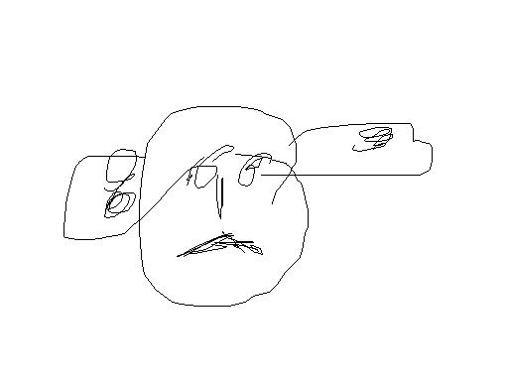
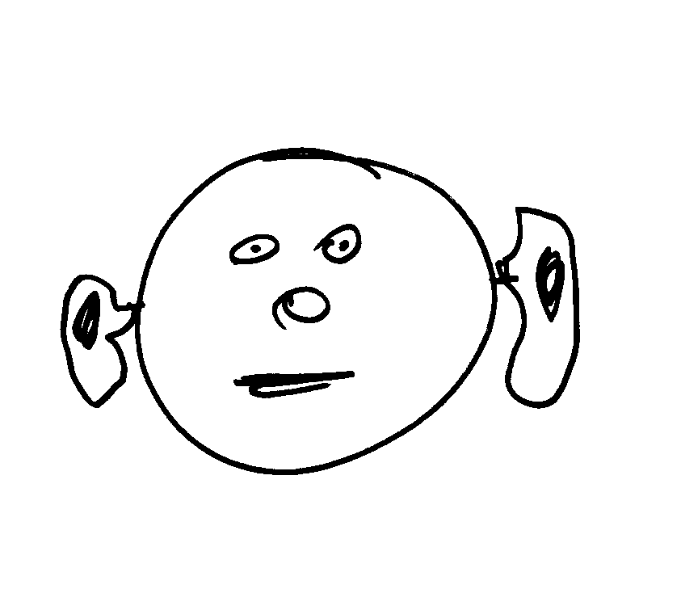
Two examples of high degree of spread
5-year old 6-year old

Slide 139

Low degree of spread:
e.g., 9 y/o Jason
The HL
“The HL is a mean, green, strong, pointy-eared monster. . . I’m not sure what he wants. . . He wants me to hear worse.”

Slide 140
J: “It’s strong, real mean and will take over my ears,” Jason said.
MH: “What would you like to do to it?” I asked.
J: “Walk away.”
MH: “Then what will happen?”
J: “It’ll chase me.”
MH: “When the HL sees your HA, what do you think it’ll do?”
J: “He (HL) gets mad at the HA, cuz it’s supposed to make me hear better. He’ll probably go bother someone else.”

Slide 141

Working with children
“All children are artists. The problem is how a child can remain an artist once he grows up.”
Pablo Picasso

Slide 142
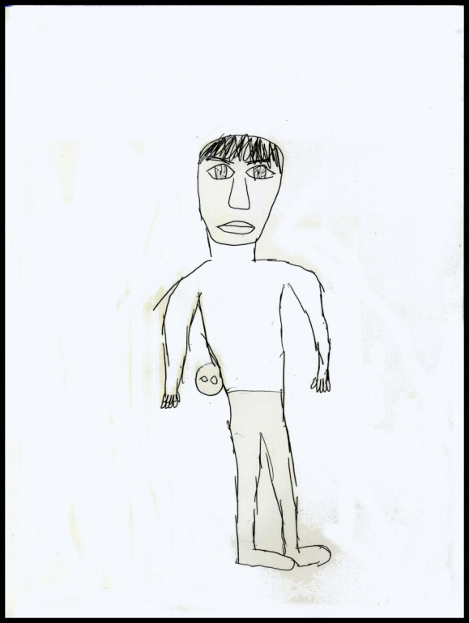
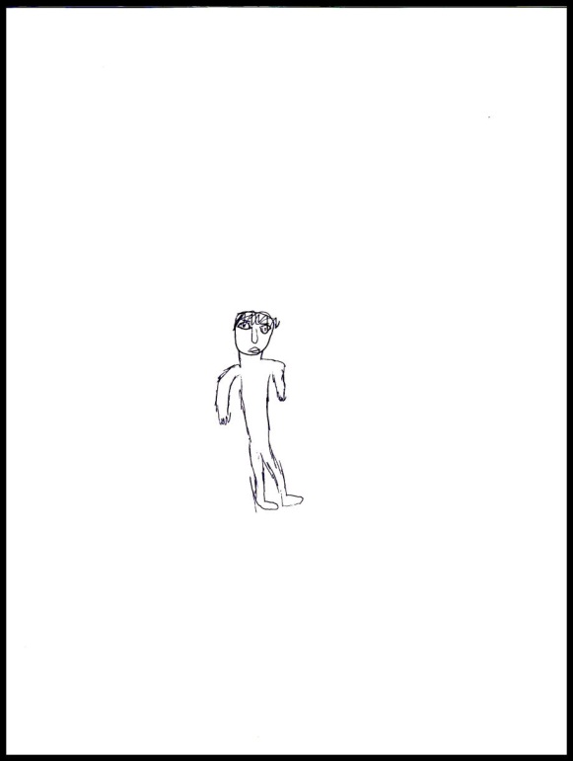
11 y/o Sam’s drawings of “The Hearing Loss”
Before and After Hearing Aids
The HL
The HL
Before Hearing Aids
After Hearing Aids

Slide 143
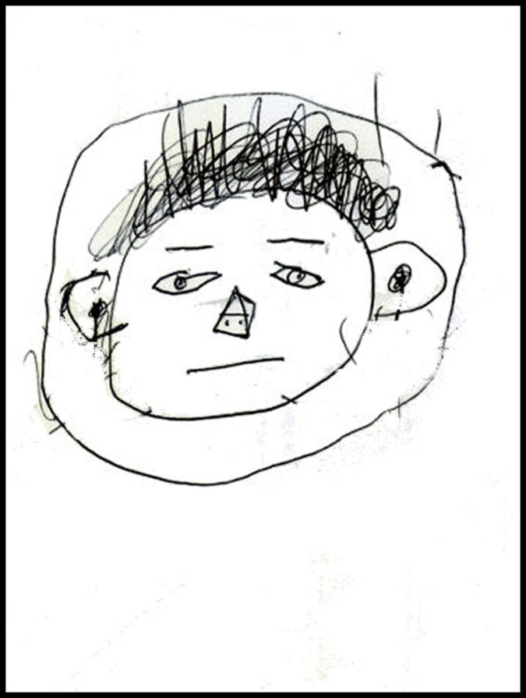
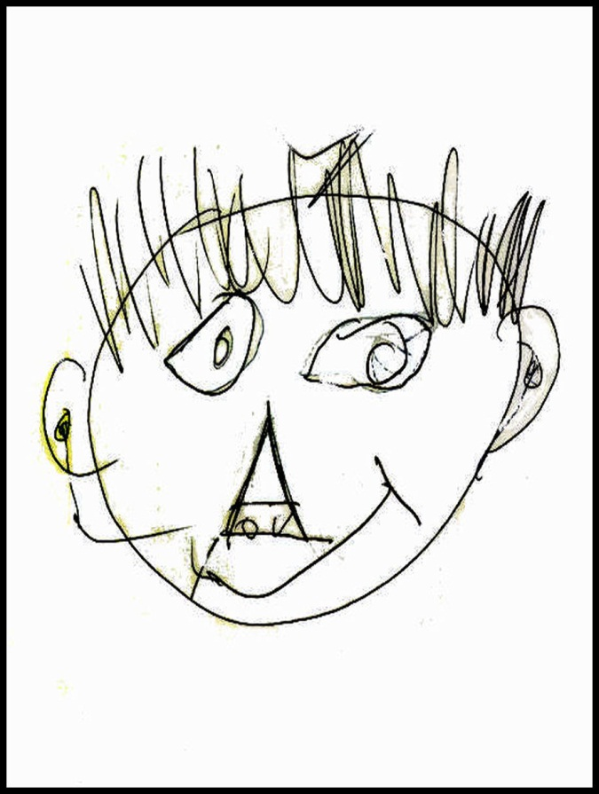
10 y/o Louis: Two Self Portraits
HA broken. 1st session tx
HA fixed. 6 months later

Slide 144
Externalizing “The Hearing Loss” means to
A. Refer to HL as if it’s separate from the patient although it influences him/her
B. Deny the implications of hearing loss to make the patient feel better
C. Delineate the difference between conductive and sensori-neural hearing loss

Slide 145
Agenda
Achieving likability,
Mitigating traumatic transference,
Understanding a patient’s psychological construction of HL,
Eliciting and sharing transformative stories,
Motivational Interviewing,
Externalizing the HL,
Facilitating conversational pivotal junctures,
Nuts and bolts of collaboration,
Managing the family and social networks,
Deliberate use of spontaneous humor,
Making effective mental health referrals.

Slide 146
“It’s not that my audiologist hadn’t explained many times what hearing aids could do for me,” John began. “It’s just that, for some reason, this time, it clicked!”

Slide 147
After the audiologist explained . . .the patient paused, gazed to the right and said, “You know, I never thought of it that way. Wow! This is making sense!” Then he nodded his head and looked upward.
In this pivotal juncture, the patient was psychologically transported to a new emotional place and state in which he could arrive at an a-hah, kathartic moment.
According to neurolinguistic programming (NLP), the telltale sign of when patients process new information is lateral eye moments: when they look to the side or upward (Grinder & Bandler, 1976).

Slide 148
Katharsis (not catharsis):
When one is emotionally moved or psychologically transported by powerful life events; to events that strike a chord for us, that we are drawn to, that fire our curiosity

Slide 149


“Stick-ability”
The longer you can stay with the present moment and explore the katharsis, the more pathways to change emerge. The objective here is to authenticate patients’ “a-hah” epiphanies and to increase their “stick-ability”
For example, one patient remarked, “You know, I never thought of it that way. Wow! This is making sense!”
“Something just clicked for you. Catch me up, will you?” the audiologist responded. “You just went somewhere and realized some important things.”

Slide 150
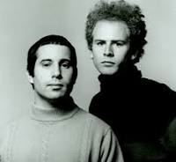
Respecting the Sounds of Silence
Patients are able to produce pivotal junctures partially due to our efforts to provide space through a slower conversational pace and to, at times, refrain from interrupting silence.
It is important to allow the patient to have a free moment during the conversation to process and formulate questions or responses. Note that this practice may not come naturally given the inherent time pressure of back to back appointments.

Slide 151


Slide 152
For many of our older patients, their ability to process rapid speech is diminished. It’s important to speak slowly with simple words (not medico-legal jargon) and to present these words clearly with excellent visual cues.

Slide 153
Agenda
Achieving likability,
Mitigating traumatic transference,
Understanding a patient’s psychological construction of HL,
Eliciting and sharing transformative stories,
Motivational Interviewing,
Externalizing the HL,
Facilitating conversational pivotal junctures,
Nuts and bolts of collaboration,
Managing the family and social networks,
Deliberate use of spontaneous humor,
Making effective mental health referrals.

Slide 154
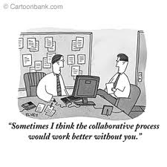

Slide 155
We often think we’re collaborating with a patient when we’re not.

Slide 156
Barriers to successful
collaboration
A pt empowered himself by routinely missing appointments.
Despite being told that hearing aids would help him be more fulfilled, the audiologist reminded him of an undertaker.
A pt refused HA as it would only make her adult son more smug.
“I know it makes no sense, but getting hearing aids will make my hearing even worse than it is now.” (“magical thinking.”)
“Going to Dr. Smith makes me feel guilty, because I know that I should have taken care of my hearing better.”
“Although I may hear better, I’ll feel more. . . “ [flawed, old, stupid, defective, deficient, ugly, weak, shut out].

Slide 157

Adolescence begins when children stop asking questions, because they know all the answers.

Slide 158
Attempting to collaborate with
Paul (15 y/o, hoh male)
First 5 minutes of session #1
Paul shouted, “I don’t need hearing aids! And tell my mom I don’t need to be dragged in here for counseling.”
“Why don’t you need hearing aids?” I asked.
“They don’t help me understand anything better.”
“How much do you think you understand at school without them?”
“It doesn’t matter,” Paul replied. “School’s boring. I’m gonna be a fisherman like my dad. You don’t need hearing aids to fish.”

Slide 159
My proposal to Paul:
“You’ll wear your hearing aids every day at school for the next month. Every morning before you wake up, your father will remove your HA battery or leave it in, according to a coin flip. He’ll then give the HA to your mother who will give it to you. Neither you, your mother nor your teachers at school will know if the batteries are in or not.
Every day, you and your teachers will estimate what percentage of classroom conversation you’re able to understand. At the end of the month, we’ll correlate when your HA were working with your and your teacher’s estimations of how much you understood.”

Slide 160
Paul’s data
%
understood

Slide 161
Attempting to collaborate with Bob (16 y/o, hoh male)
“You don’t wanna be here, do you?”
He shook his head.
“Neither do I. What would you rather be doing?”
“Hanging out” he grunted.
“Me too. Looks like we’re stuck with each other for a while.”
No response.
“How would you hang out if you didn’t have to be here?” I asked.
“I hang out in my bedroom, but my mom’s always badgering me to clean it up.”
“Like what I don’t do when I’m cooking, you don’t make a mess, right?”
“You got that right” he agreed.
“I’ll convince your mother if you convince my wife?”
First a smirk, then a nod!

Slide 162
It’s important to connect beyond the presenting problem
(something that has nothing to do with HL)
And to have fun doing it!!!

Slide 163
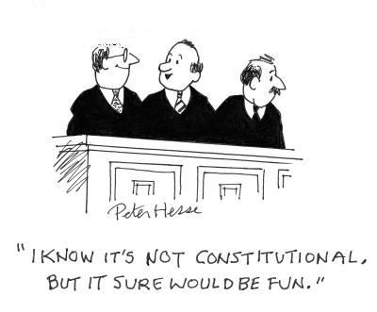

Slide 164
More tips to facilitate collaboration
Avoid unsolicited advice
“I have an idea. Can I share this with you?”
Ask permission first
“Is this a good time to talk about . . . ?”
Dual expertise: local v expert knowledge
“Here’s my concern for what it’s worth. I know too many people who keep nodding their head, pretending to understand, that get begin to develop neck difficulties. I don’t want that to happen to you. Do you?”

Slide 165
Agenda
Achieving likability,
Mitigating traumatic transference,
Understanding a patient’s psychological construction of HL,
Eliciting and sharing transformative stories,
Motivational Interviewing,
Externalizing the HL,
Facilitating conversational pivotal junctures,
Nuts and bolts of collaboration,
Managing the family and social networks,
Deliberate use of spontaneous humor,
Making effective mental health referrals.

Slide 166
There are invisible people in your office
Unraveling the patient from the family
Pssss

Slide 167
Circular questioning of Joan
A: “How can I help?”
J: “I came for hrng test and HA.”
A: “Would you tell me who referred you or knows that you came for a hearing test?”
J: “My son.”
A: “Tell me about your son.”
J: “Well, he’s Mr. Know-it-all, and has been badgering me to get hearing aids for years.”

Slide 168
A: “I see (smiles). Who else is concerned about a possible hearing loss?”
J: “My daughter Janice and her husband, Tom.”
A: “And which of them – Mark, Janice, or Tom – would be most concerned if you did or did not get hearing aids?”
J: “Definitely Mark. Janice and Tom are more compassionate. They would understand that it’s my decision.”

Slide 169
A: “I see. And what would they do?”
J: “Mark would get angry and scold me. Janice would come to my defense, and they would fight. Then eventually Tom would break it up.”
A: “Whew. And how would all that affect you?”
J: “I want no part of it. I want out of this family. Mark can take his hearing aids and… And frankly, since my husband died, life’s not worth living anymore.”

Slide 170
Who are the invisible people in the office?
Mr. “know it all” son, Mark
Daughter Janice
Janice’s husband, Tom
Deceased husband

Slide 171
Once again, don’t be in such a hurry to help.
First build rapport and understand the pt’s
internal landscape.
and external

Slide 172
Circular questioning:
How to find out out who those invisible people are:
The Relevant System.
“Who referred you for this meeting?”
Assesses who has vested interest in the session and who therefore may represent support or resistance.
“Who knows about this meeting?”
Elicits the important family members and multiple helpers.
“Who will notice improvement in your hearing first, second, third, etc.?” “Who will not notice at all?”
Elicits degrees of closeness/distance.

Slide 173
Circular questioning 2
“Who will be most pleased if your hearing improves? Who will be the second most pleased? And then who? Etc. Who will be the most upset if your hearing doesn’t improve? And then who? Etc.
Begins to elicit alliances/coalitions.
“What do you think will happen between [any two people] if your hearing improves? If your hearing doesn’t improve?
More elicitation of alliances/coalitions around particular content
themes.
“Who do you think the outside help has helped the most? And then who? Etc.
Elicits historical alliance information and perceptions of help/no-
help.

Slide 174
Connect with a helpful protagonist
Sales consultant Neil Rackham : “As the size of the decision [of the large sale] grows, more people become involved. Your success may often depend not just on how you sell, but on how well the people in the account sell to each other. . . when the people you sold to go back and try to convince the others.”

Slide 175
The two most powerful people -- the protagonists -- in Joan’s system are Joan and her son, Mark. Other helpers have connected only with “know it all son” but did not also connect with Joan
Joan
Audiologist
Mr. “know it all” son, Mark
Daughter Janice
Janice’s husband, Tom
Deceased husband

Slide 176
J: “I want no part of it. I want out of this family. Mark can take his hearing aids and… And frankly, since my husband died, life’s not worth living anymore.”
A: “It feels very bleak to you, I bet. Lot of emotions and people involved.”
J: Nods her head.
A: “So we may not want to go full force toward fitting you with hearing aids. But would it be okay if we maybe talk for a bit about your concerns and go ahead and test your hearing, but hold off on treatment until I understand more how it would fit into your life and family issues?”
J: “Absolutely!” Joan responds appreciatively.

Slide 177
Circular questioning with 16 y/o Bob
“Whose idea was our meeting and what was his/her stated reason?” “This appointment was my mom’s dumb idea.”
“Do you agree or disagree with your mom and why?” “What do you think? There’s no way I’m gonna wear hearing aids.”
“Who might your parents tell about this appointment and what would be their response to your parents or you?” “My mom would tell the whole world about this appointment if she could – my grandparents, Uncle Pete, Aunt Joanne, and her friends [he listed their names]. They would all be on her side.”

Slide 178
“Who might you someday tell about this appointment? What do you think their response would be?” “I’m not telling anyone that I came here. Well, maybe I’d tell my best friend, Jack, cuz I tell him everything.”
“If Jack were here, what would he say to you about your hearing loss, hearing aids, or you using an FM system at school?” “Jack would say that my parents are jerks, that they treat me like I’m a baby and he’d say that I do just fine without hearing aids and without the teacher speaking into a microphone.”
“What would you say back to your Jack?” “I would say to Jack that I agree with him.”

Slide 179
“What do you think Jack would say to your mom?” “That she and everyone should mind their own business.”
“Which of the above persons are most concerned about your hearing loss?” “After my mother, my grandpa would be the most concerned about my hearing and want me to use hearing aids, cuz he’s always after me to do well in school; then aunt Joanne who has an opinion about everything; Uncle Pete who’s stupid; and then some of my mom’s boring friends who are teachers: Diane and Sandy and maybe Sis, but maybe not Sis cuz she’s kinda cool and has an open mind.”

Slide 180
“What advice would Jack have for you when you talk to certain others about hearing loss and hearing aids?” “I usually hang out with Jack after I fight with my parents. He tells me not to yell or swear at them, because I’ll get in more trouble.”
“What would happen between you and your mom’s friends/family if you do or don’t get HA?” “If I do get hearing aids, my family and all my mother’s friends would probably have a big party or celebration or something, but I wouldn’t go. If I don’t get hearing aids, maybe my mother’s friend, Sis, would understand because she’s cool and my father would be okay with it. We talk about sports a lot, and he doesn’t get involved in arguing with me like my mom does.”

Slide 181
“Given that you end up getting or not getting hearing aids, what would your parents say or do with each other? How might that affect you?” “If I don’t get hearing aids, my parents would probably fight; my mom would cry and my dad would say ‘Just leave the poor kid alone.’ I would leave the house more because I hate seeing them fight. After that, my mother would probably sulk and avoid me and my father would spend less time in his office and maybe watch a Sox game with me to try to cheer me up.”

Slide 182
Multiple choice question:
Inviting which of the following people to Bob’s audiology appointment would increase the likelihood he would agree to amplification?
His “stupid” mother
His mother, “opinionated” Aunt Joanne, “ditsy” Uncle Pete and mother’s “boring” friends
Aunt Joanne and Uncle Pete
His best friend, Jack

Slide 183
I asked Bob and Jack to write a list of questions for the audiologist. They came up with the following:
Can you show us how much hearing Bob has?
What does he miss?
Can you show us what he would hear with hearing aids and an FM system at school?
Will his hearing get worse without this stuff?
Is there any other way to hear better without having to wear hearing aids?
What kind/size/color hearing aids do you have?
Will his hearing get worse or better?

Slide 184
The purpose of circular questioning is
A. to understand the dynamics or “dance” of significant others who influence, and are influenced by, audiologic recommendations.
B. to delineate one’s adjustment to hearing loss.
C. to make your office more circular, less square-like

Slide 185
The phrase, “There are invisible people in your office” means
A. fitting patients with hearing aids can precipitate a psychotic break
B. the presence of ghosts are other supernatural phenomena
C. that a patient’s family, friends, etc. influence his/her adherence to recommendations

Slide 186
Agenda
Achieving likability,
Mitigating traumatic transference,
Understanding a patient’s psychological construction of HL,
Eliciting and sharing transformative stories,
Motivational Interviewing,
Externalizing the HL,
Facilitating conversational pivotal junctures,
Nuts and bolts of collaboration,
Managing the family and social networks,
Deliberate use of spontaneous humor,
Making effective mental health referrals.

Slide 187
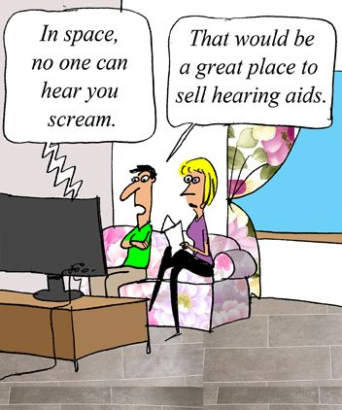

Slide 188

The Health Benefits of Humor
and Laughter
Aids group

Slide 189
Wanted:
One Volunteer to ask me the following two questions:
Are you the famous comedian we’ve all been hearing about?
To what do you owe your success?

Slide 190
Timing is everything
“While humor can ease difficult interactions between doctor and patient, clinicians should be careful not to initiate humor without a clear lead from the patient, as some patients will view it as hurtful. I very seldom use a lot of humor during my first visit because I’ve got to figure out acceptable boundaries of communication.”
Physician

Slide 191
“Humor may help to relax the patient, acting as a ‘leveling agent’ among the patient, family, and physician, as it can often relieve the tension caused by intimate questions or exams.”
Oncologist
Humor is very effective in lessening traumatic transference; it’s an exquisite equalizer

Slide 192
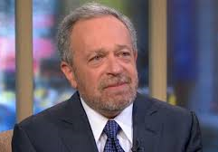
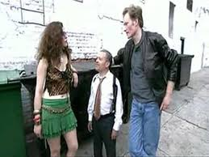
Robert Reich
He often starts speeches by saying, "They told me to be short.“
He may display his stepstool to declare, “I am the only candidate for governor with a real platform.”
"When I was labor secretary. I used to stand up in front of business audiences and say, 'Do I really look like big government?' And I do it just because there's not enough humor in public life."

Slide 193
Story of Chris: “I am NOT feeling guilty!!!”
From a parent of a newly dx deaf child
“Coming to terms with having a deaf child made me feel less human. My son’s audiologist understands all of this, and sometimes will laugh. His warmth and humor sometimes make me laugh as well . . which proves to me that, even as my hope and spirit challenged, that there was still something to smile and laugh about. I was still a vital human being.”

Slide 194


Slide 195
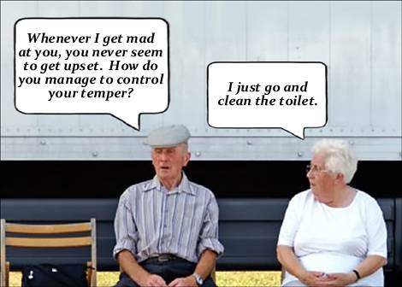

Slide 196
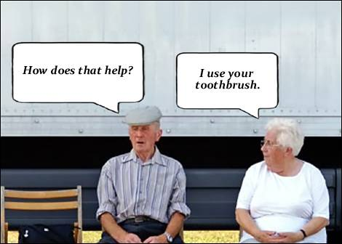

Slide 197
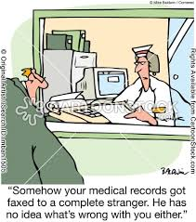

Slide 198
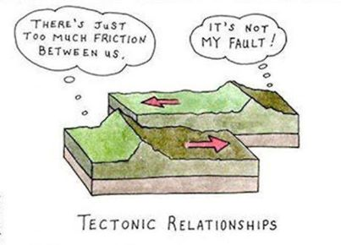

Slide 199
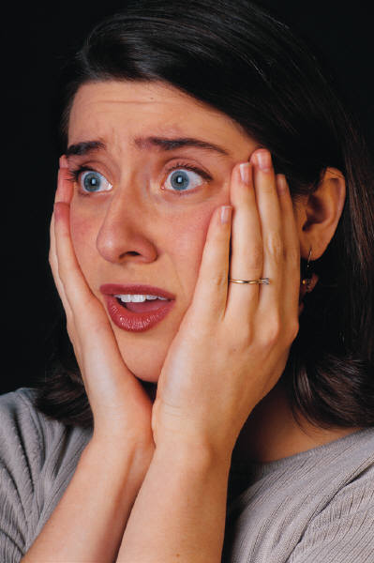
Pt: “It’s not my ears. My wife mumbles.”
Audiologist: “OMG, you’re the up-teenth person who’s told me this. It must be an epidemic!!!”

Slide 200
“At the beginning of my shift, I placed a stethoscope on an elderly and slightly deaf female patient's anterior chest wall. 'Big breaths,' I instructed. 'Yes, they used to be,' replied the patient.”
Submitted by Dr. Richard Byrnes, Seattle , WA

Slide 201
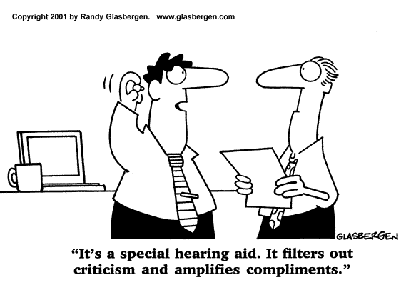
Perhaps in your waiting room??

Slide 202
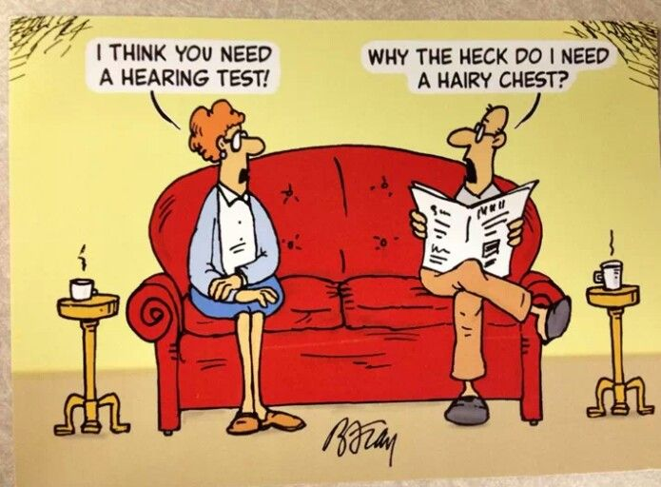

Slide 203
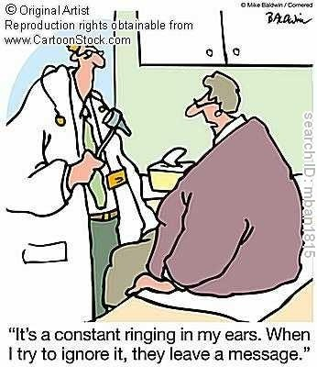

Slide 204
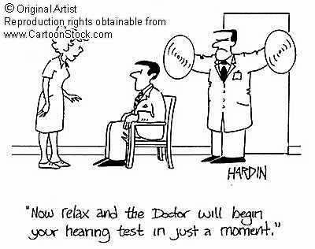

Slide 205
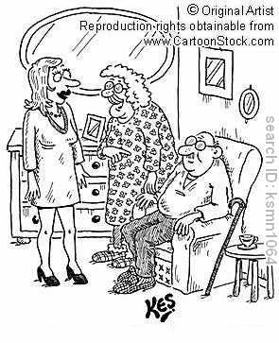
“Me and your granddad have been married for sixty years, but he still whispers sweet nothings into my hearing aid.”

Slide 206
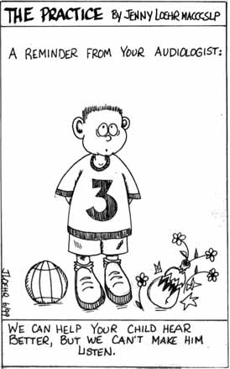

Slide 207
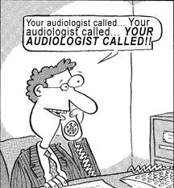

Slide 208
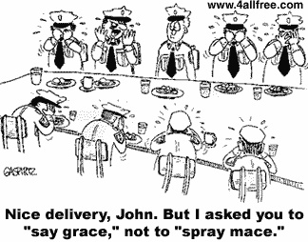

Slide 209
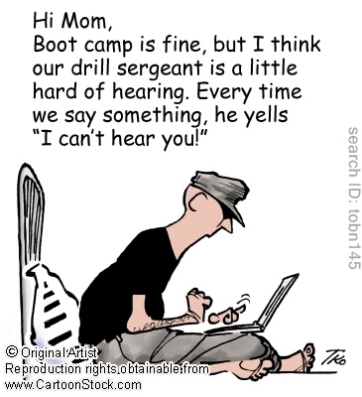

Slide 210
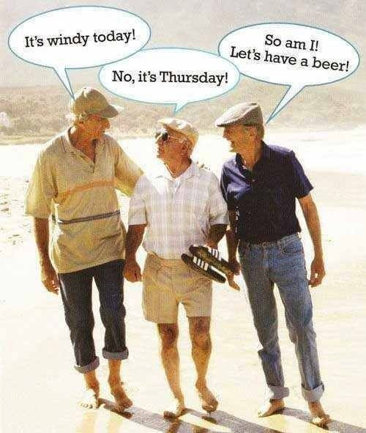

Slide 211
The use of humor in a patient visit is
A. Never a good idea.
B. Always a good idea
C. If done carefully and respectfully, often results in better rapport

Slide 212
Agenda
Achieving likability,
Mitigating traumatic transference,
Understanding a patient’s psychological construction of HL,
Eliciting and sharing transformative stories,
Motivational Interviewing,
Externalizing the HL,
Facilitating conversational pivotal junctures,
Nuts and bolts of collaboration,
Managing the family and social networks,
Deliberate use of spontaneous humor,
Making effective mental health referrals.

Slide 213
Make psychotherapy referral, prn
“You can only wear so many hats and we shouldn't beat ourselves up if we can't solve all of a given patient's problems with HL. Part of being a good audiologist is recognizing when a patient is having a tough time dealing with hearing loss and making an appropriate referral to a psychotherapist who is trained to deal with these issues..”
Audiologist
This is easier said then done

Slide 214

Red flags for initiating mental health referral
Suicidal verbalizations
Expressions of hopelessness
Tearfulness
Manifestations of rage
Person withdrawing from pleasurable activities
Sleep disturbance
Isolation (“No one understands”)
Recent significant losses, e.g., spouse
Abrupt change of behavior

Slide 215
“Thank you, Mike, for your call.
“But suggesting mental health counseling to a patient could be badly bungled by even the most well intentioned professional. There are lots of ways that could be misunderstood or presented in a poor way. It makes me nervous going that route.”
Owner of an audiology practice

Slide 216
What not to say:
“Emotional issues are beyond my area of expertise, so I’m referring you to a psychotherapist.”
“I’m sorry, we can’t get into emotional stuff here, our appointment is only 10 minutes. A therapist can help you.”
“Do you think you need psychotherapy?”
“Given the pain that you feel, you can benefit from therapy.”

Slide 217
What to do
Validate and contain the patient’s feelings
For example:
“Many people also say that they feel anxious about their hearing loss. We only have 5 or 10 minutes, but would you give me a snapshot of how you’re feeling anxious?”
“It sounds like you have a lot of painful feelings. I can appreciate that, as I’ve heard many many people with hearing loss talk about this a lot. We don’t have more than a few minutes, but I’d really appreciate it if you could give me a glimpse of your pain.”

Slide 218
Normalize (de-stigmatize) the referral
For example:
“Many people with hearing loss feel it’s helpful to really talk about the emotional stuff that you just talked about. I know someone . .”
“I have found that people benefit more from hearing amplification if they talk about the emotional adjustment issues.”
“There is a set of psychological skills that people with hearing loss learn to use. Would you be interesting in meeting with . . .?”
You know, there are audiological ways of helping with hearing loss and there are also psychological techniques. The first is something I do; the second is another professional I know.”

Slide 219
Emphasize that optimal treatment of hearing loss necessitates a team approach
For example:
“I’m happy and proud to tell you that we have a kind of ‘dream team’ to help people ..”
“I’ve found it more successful to use a holistic, team approach to help people benefit from hearing aids.”
“I can take care of your ears, and another person can take of your emotions; we’ll cover all bases.”

Slide 220
4. Humanize the mental health professional
For example:
“I’ve known Dr. Smith for over 20 years. She’s nice, maybe about 50-years old, been practicing psychology for over 30 years. I think she also collects antiques. She has a dry sense of humor. I think you’ll like her.”

Slide 221
Ask permission to telephone the mental health professional in front of the patient
For example:
“Is it okay if I call Dr. Jones now to give her a heads up that you’ll be calling?”

Slide 222
6. Ask the patient about the status of the referral appointment
If a patient did not follow through on contacting the therapist, an audiologist may ask:
“Hey, this is not the kind of thing that points are taken off of your final grade. But would you help me understand what you were thinking or feeling that may have made you not make the call?”
“You know, this is easy for me to suggest. I have the easy part. Tell me how it feels for you?”
“Is there any information or assurances about Dr. Shlomo that I can give you that would be helpful?”

