Slide 1
How to Become a Recognized Expert in Your Field
Dorie Clark
@dorieclark

Slide 5
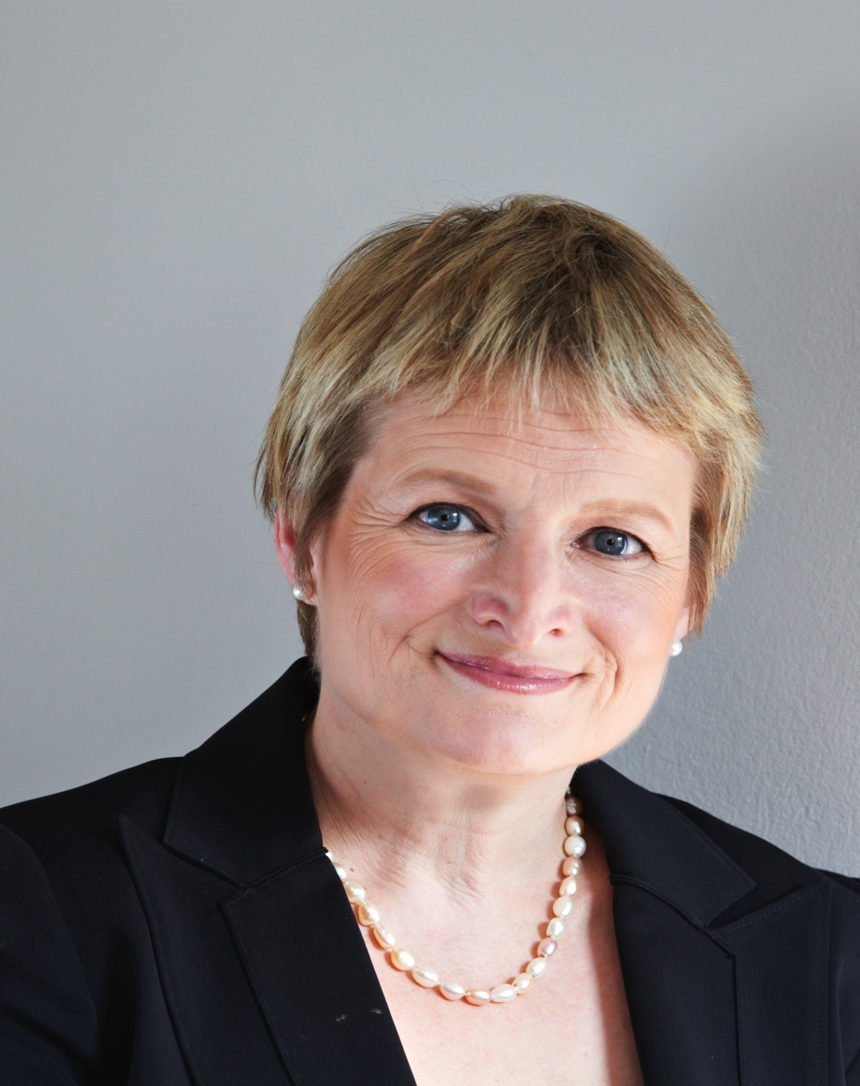
Ask:
What’s Next?

Slide 6
Expand Your Niche
Dorie Clark

Slide 7
Combine Ideas
Dorie Clark

Slide 8
Create a Framework
Dorie Clark

Slide 10
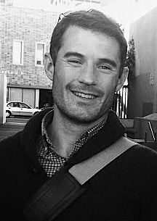
Share Your Ideas

Slide 12
Create a Network
Dorie Clark

